Slide 1
Quiz 1
Instructions
Do as directed:
Step 1:
Read the five source files (provided as input) in python one by one.
Step 2:
Use the keywords given on the next slide, and count the frequencies of those keywords in the source files

Slide 2
Keywords (20):
Risk, threat, vulnerability, cybersecurity, security, privacy, officer, access, sensitive, breach, attack, encryption, technology, management, Critical, protection, framework, network, secure, private
Note: Please don’t consider the case sensitivity of words while creating the frequencies, e.g. the word “Private” and “private” should be same words (no discrimination in upper case and lower case letters)

Slide 3
Step 3:
Find the frequency of each keyword in the five input files and develop five histograms of frequencies of these keywords.
Step 4:
Use the cosine similarity discussed in chapter 2 (given and explained as example in next slides) to find the similarities between the documents

Slide 4
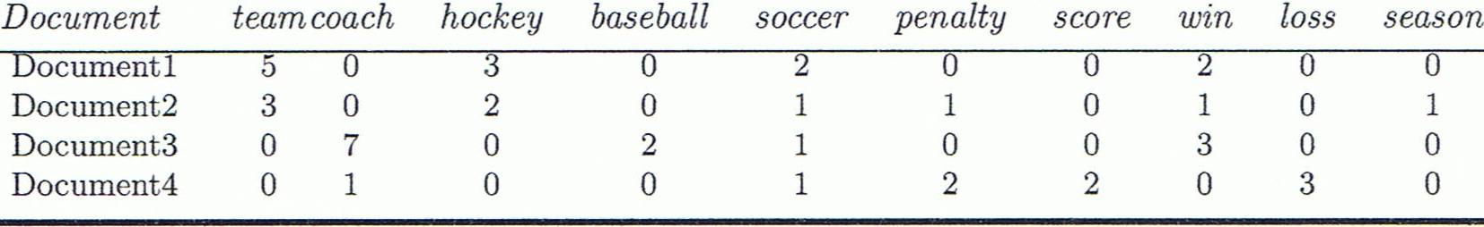
Cosine Similarity
A document can be represented by thousands of attributes, each recording the frequency of a particular word (such as keywords) or phrase in the document.
Other vector objects: gene features in micro-arrays, …
Applications: information retrieval, biologic taxonomy, gene feature mapping, ...
Cosine measure: If d₁ and d₂ are two vectors (e.g., term-frequency vectors), then
cos(d₁, d₂) = (d₁ • d₂) /||d₁|| ||d₂|| ,
  where • indicates vector dot product, ||d||: the length of vector d

Slide 5
Example: Cosine Similarity
cos(d₁, d₂) = (d₁ • d₂) /||d₁|| ||d₂|| ,
  where • indicates vector dot product, ||d|: the length of vector d
Ex: Find the similarity between documents 1 and 2.
  d₁ = (5, 0, 3, 0, 2, 0, 0, 2, 0, 0)
  d₂ = (3, 0, 2, 0, 1, 1, 0, 1, 0, 1)
  d₁•d₂ = 5*3+0*0+3*2+0*0+2*1+0*1+0*1+2*1+0*0+0*1 = 25
  ||d₁||= (5*5+0*0+3*3+0*0+2*2+0*0+0*0+2*2+0*0+0*0)^{0.5}=(42)^{0.5} = 6.481
  ||d₂||= (3*3+0*0+2*2+0*0+1*1+1*1+0*0+1*1+0*0+1*1)^{0.5}=(17)^{0.5} = 4.12
  cos(d₁, d₂ ) = 0.94

Slide 6
Deliverables (Submit only one MSWord file that contains all answers)
Python code for creating the frequencies
Histogram of each file against the keywords
Prepare a table showing the cosine similarity values of documents (no need for diagonals)
Conclude which documents have highest and lowest similarity with each other
 | File1 | File2 | File3 | File4 | File5
File1 | 0
File2 |  | 0
File3 |  |  | 0
File4 |  |  |  | 0
File5 |  |  |  |  | 0

